Slide 1
Model Validation and
Fairness in Machine
Learning
2024 Marcus Evans – Model Validation Class
Nicholas Schmidt, SolasAI
June 13, 2024

Slide 2
Introduction
Background: Can machine learning discriminate? What causes model discrimination?
Discrimination and the law: Relevant statutes and the burden-shifting test
Impact, validity, and bias: Understanding the source of the problem
Fixing the problem: searching for less discriminatory alternative models
NOTE: The author is not a lawyer; this presentation does not represent legal or compliance advice.

Slide 3
A Little Bit About Me
Nicholas Schmidt
Nearly 25 years of experience applying concepts from statistics and economics to law and regulatory compliance questions.
Founder & Chief Technology and Innovation Officer, SolasAI
SolasAI software measures and mitigates discrimination risk.
Prominent U.S. lenders, insurers, and health insurance companies use SolasAI to assess and mitigate discrimination risk.
AI Practice Leader, BLDS, LLC
We are the fair lending analytics advisors to lenders representing over 70% of credit cards issued in the United States.
Regulators and courts regularly engage us to provide guidance on discrimination risk in algorithms.

Slide 4
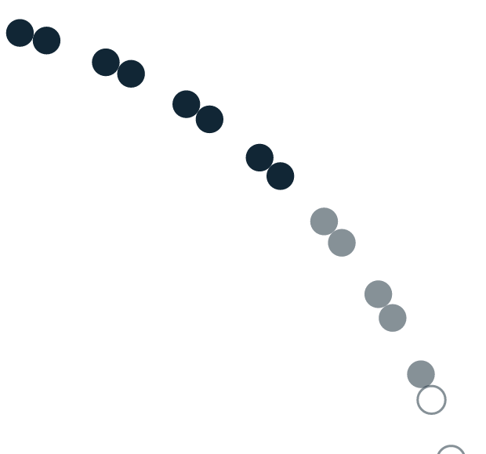


Multiple Forces are Requiring Enterprises to Test and Justify Model Fairness
Expectations are rapidly shifting towards the need to test and justify model fairness… regardless of size or industry. Model builders are going to be expected to:
Increased Model Usage
Increased Model Risks
Test for disparities
Identify opportunities to reduce disparity
Provide clarity on trade-off decisions between business value and reducing disparities
Increased societal awareness
Increased focus from regulators
Regulators and courts looking to establish precedent
4

Slide 5
Background
Can AI Discriminate?

Slide 6
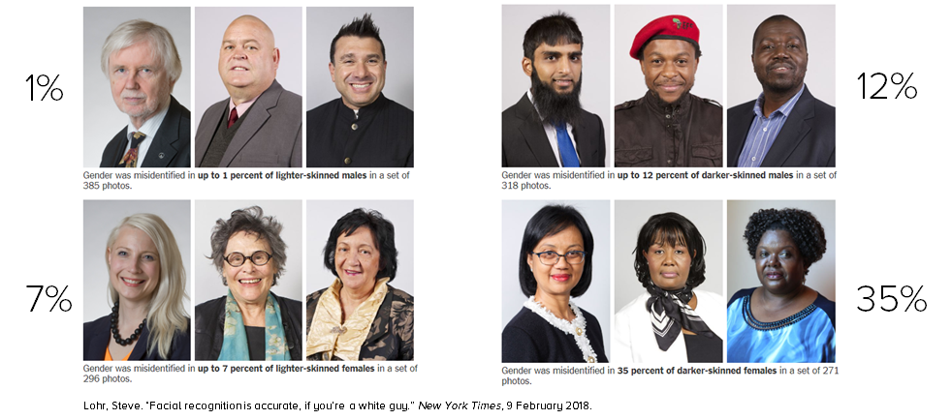
Can Algorithms Discriminate?

Slide 7
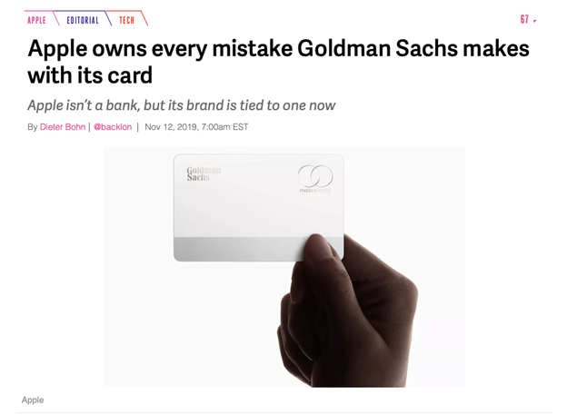
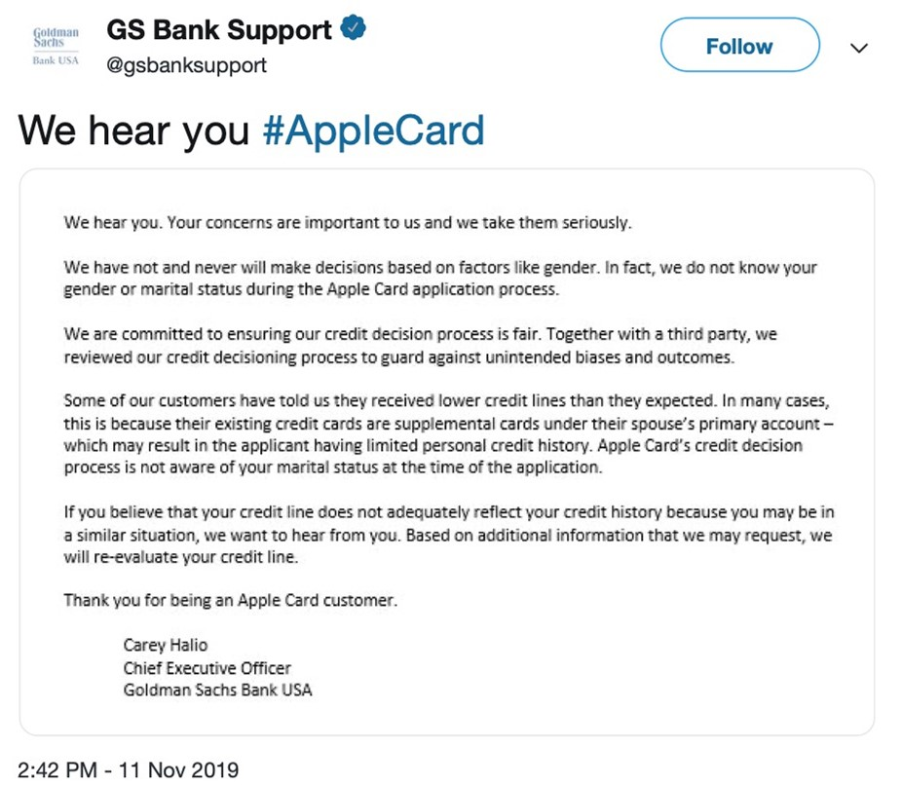
The Effect of Two People on Twitter…

Slide 8
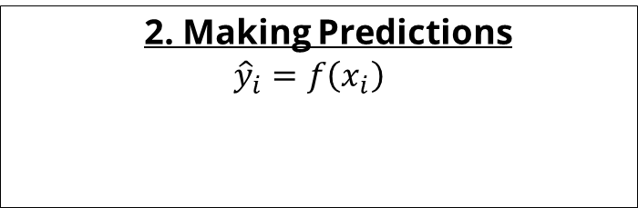
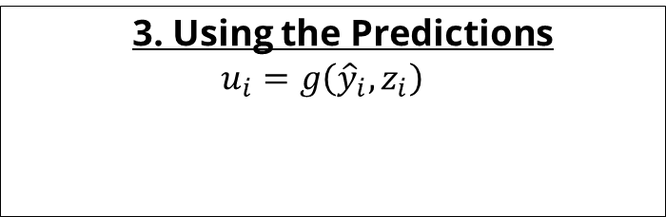

Where can a model discriminate?
1. Building the model
$$Y=f\left(X\right)+ε$$
2. Making Predictions
$${\hat{y}}_{i}=f\left(x_{i}\right)$$
The model’s prediction for the individual, i.
The obtained and used data for individual i.
The label or dependent variable. E.g., loan default, mortality, clicking on an ad.
The model’s error: unmeasured, unmeasurable, or excluded factors that influence the true outcome, Y.
The model from the left panel – trained on data, likely from other people, X.
3. Using the Predictions
$$u_{i}=g\left({\hat{y}}_{i}, z_{i}\right)$$
The trained model, built on data, X, using some method chosen by the data scientist.
The data used to build the model.
, Z
The outcome individual, i, experiences. E.g., offer, APR, outreach, etc.
The model’s prediction and other factors used to make a decision for individual, i.
The selection method – typically business rules based on profit maximization or risk mitigation.

Slide 9
The Problem of Model Systems
Addressing algorithmic discrimination is essential.
But algorithms may play a small role in a model system.
Model systems can and should be evaluated for the potential to mitigate discrimination.
Existing differences in customer demand
Business decisions regarding markets and locations
Preferences based on pre-existing customers
Marketing & Targeted Outreach
Marketing Responses and Applications
Credit Model Assessment
Credit Offers

Slide 10
Discrimination and the Law
Relevant Statutes and Concepts

Slide 11
Selected Relevant Federal Statutes
Equal Credit Opportunity Act (ECOA): Prohibits discrimination in consumer credit.
Fair Housing Act (FHA): Prohibits discrimination in most housing-related transactions.
Title VII of the Civil Rights Act of 1964: Prohibits discrimination in employment.
Law | Primary Protected Classes
Equal Credit Opportunity Act (ECOA) | Race, Color, Religion, National Origin, Sex, Marital Status, Age, Receipt of Public Assistance
Title VII of the Civil Rights Act | Race, Color, Religion, National Origin, Sex
Fair Housing Act (FHA) | Race, Color, Religion, National Origin, Sex, Familial Status, Disability

Slide 12
Types of Discrimination
No Relationship Between Protected Class and Outcome
Disparate Impact
Proxy Discrimination
Disparate Treatment
Increased Regulatory, Reputational, and Legal Risk

Slide 13

Disparate Treatment Discrimination
Perhaps the most obvious form of discrimination.
Where protected class status is used in the decision-making process.
In an algorithm, this would manifest as a variable for protected class status being included in the model.
Disparate Treatment Discrimination:
Where X are the valid features of the model and p is an indicator of protected class status.
$$y=f\left(X,p\right)$$

Slide 14
Proxy Discrimination
There are two types of proxy variables
“Stand-alone proxies”
A stand-alone proxy is a variable or set of variables so closely related to protected class status that they effectively represent the inclusion of protected class status as a variable in a model (i.e., nearly disparate treatment).
“Predictive Proxies”
A predictive proxy occurs when features only have predictive power because of their relationship to a protected class.

Slide 15
Stand-Alone Proxies
Typically measured with some kind of correlation or information measure.
Information Value: Perform a Weight of Evidence (WoE) transformation (this can be done with PiML) and then calculate Information Value (IV). If the IV is greater than 0.3, this is evidence that the variable has proxy risk.
Calculate correlations and compare to a threshold – typically 0.80 to 0.95. If the correlation is greater than the threshold, then this is indicative that a variable has proxy risk.
Another technique that straddles the stand-alone and predictive proxy definitions is measured by calculating the following ratio: Ratio = CORR(x, p) / CORR(x, y). If Ratio > 1 and CORR(x, p) > 0.3, then there is evidence that the variable is a proxy risk.

Slide 16
Predictive Proxies
In a logistic or OLS model, a predictive proxy can be identified by running the model three times:
Run the model across all observations; test coefficients for statistical significance.
Run the model for just the protected class; test coefficients for statistical significance.
Run the model for just the reference group; test coefficients for statistical significance.
If the coefficient is a statistically significant predictor for all observations, but not for either by-group model, then the variable is likely gaining its predictive power through its ability to differentiate protected class. It is then considered a high risk of being a proxy variable.
Open question: what is the best way to do this with machine learning models, where statistical significance does not get calculated?

Slide 17

Disparate Impact
Disparate impact occurs when a valid or “facially neutral” factor causes outcomes to be worse for one group relative to another.
Evidence of disparate impact does not necessarily mean the model is illegally discriminatory.
A classic example is a weight-lifting test for firefighters.
In consumer credit, we often see disparate impact in default model outcomes. Certain minority groups are predicted as being more likely to default on average than other races or ethnicities.
Disparate impact occurs when:
Here, the average outcome for the protected group (p=1) is higher than for the reference group (p=0). A higher outcome is assumed to be less favorable (e.g., probability of default).
$$E(\hat{y}|p=1)>E(\hat{y}|p=0)$$

Slide 18
Impact, Validity, and Bias
Understanding the source of discrimination in the model

Slide 19
Handling Disparate Impact
If a disparate impact is present, this does not necessarily mean that there is illegal discrimination.
In fact, it is, unfortunately, likely to occur.
Finding evidence of it does require additional steps to ensure people are being treated as fairly as possible.
Specifically, one should follow the approach of the “burden-shifting test”:
Test for evidence of disparate impact.
Ensure that the model is valid and that the factors that drive disparities are reasonable predictors.
Search for Less Discriminatory Alternative (LDA) models.
Doing a good job performing the burden-shifting analysis in-house means that regulators and plaintiffs will view you as a less attractive target.

Slide 20
Measuring Disparate Impact
Disparate impact is measured as a test of whether unconditioned outcomes differ across groups.
Disparate impact measures do not incorporate the true outcome. In other words, measures such as relative false positive rates are not measures of disparate impact.
Commonly used metrics include the Adverse Impact Ratio and Standardized Mean Difference.
$$Adverse Impact Ratio \left(AIR\right)=\frac{{Selected}_{protected group}}{{Selected}_{reference group}}$$
$$Standardized Mean Difference \left(SMD\right)=100∗\left(\frac{{\hat{Y}}_{protected group}−{\hat{Y}}_{reference group}}{σ_{\hat{Y}}}\right)$$

Slide 21
Model Validity
Model validity concerns itself with the issues of whether a model is using the right data to predict the right things for a given usage.
This is important for assessing model fairness because a model that is not valid is unlikely to be fair to members of certain groups.
Important types of validity
Face
Construct
Criterion
Content
Notes:
Construct: Does the test measure what it is supposed to measure?
Criterion: Does the test match a gold standard?
Content: Evaluates how well an instrument covers all relevant parts of the construct it aims to measure.

Slide 22
Differential Performance and Prediction
Differential Performance is found when a model does a better job (that is, it is more accurate) in measuring the outcome for certain groups relative to others.
Differential performance can be measured through metrics such as relative AUCs.
There are non-discriminatory reasons why there may be evidence of differential performance: differences in AUCs are not dispositive indicators of discrimination.
Differential prediction or bias occurs when the relationship between the model’s predictions and the true outcome being measured is not consistent across groups, leading to under- or over-prediction for certain groups.
Differential prediction can be measured by looking at relative model residuals.

Slide 23
Mitigating Discrimination
Searching for Less Discriminatory Alternative (LDA) Models

Slide 24
Making Fairer Models via Feature Selection
Model 1 - Includes Inquiries
Model 2 - Includes Time on File
Default
Default
Race
(not in the model)
Race
(not in the model)
Inquiries
Time on File
Value added to the model
Value added to the model
Disparate impact entering the model through “Inquiries”
Disparate impact entering the model through “Time on File”

Slide 25
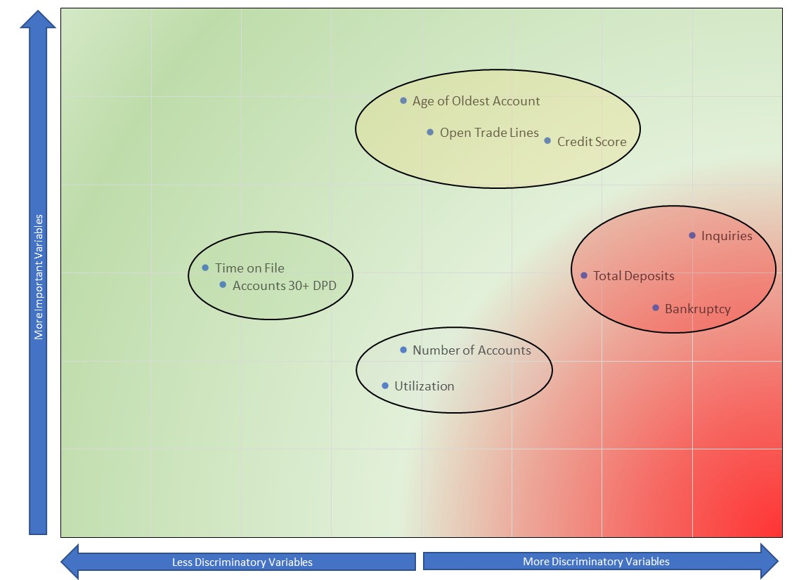
Debiasing Models Using Explainable AI
Identify the variables that are causing discrimination
Identify the variables that are highly important
Re-create the model, focusing on important, but less discriminatory variables

Slide 26
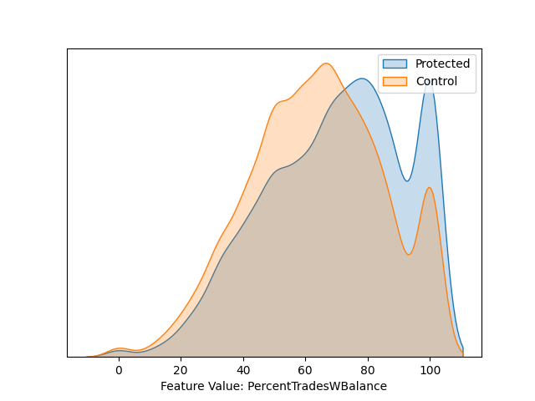
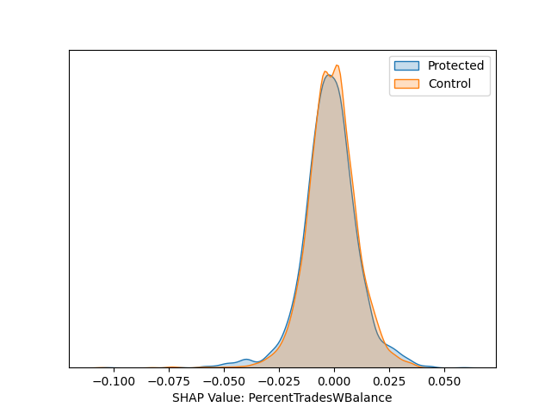
Debiasing Models Using Explainable AI
Percentage of Trades with a Balance

Slide 27
Less Discriminatory Alternative Search
The third prong of the burden-shifting test requires that a valid model that shows evidence of disparate impact undergo testing to search for less discriminatory alternative models.
The search needs to be reasonable but does not have to be onerous.
Traditionally, it was done by swapping in and out a few variables.
Other more effective techniques are supplanting this method.
Options include:
More intelligent feature selection
Hyperparameter tuning
Incorporating protected class characteristics directly into model training

Slide 28

The Multiplicity of Good Models
Because machine learning models have such flexibility, more than one model may meet all necessary model governance requirements
This gives us the opportunity to optimize on more than one metric: fairness
Worst Models
(Largest Loss)
Best Models
(Smallest Loss)

Slide 29
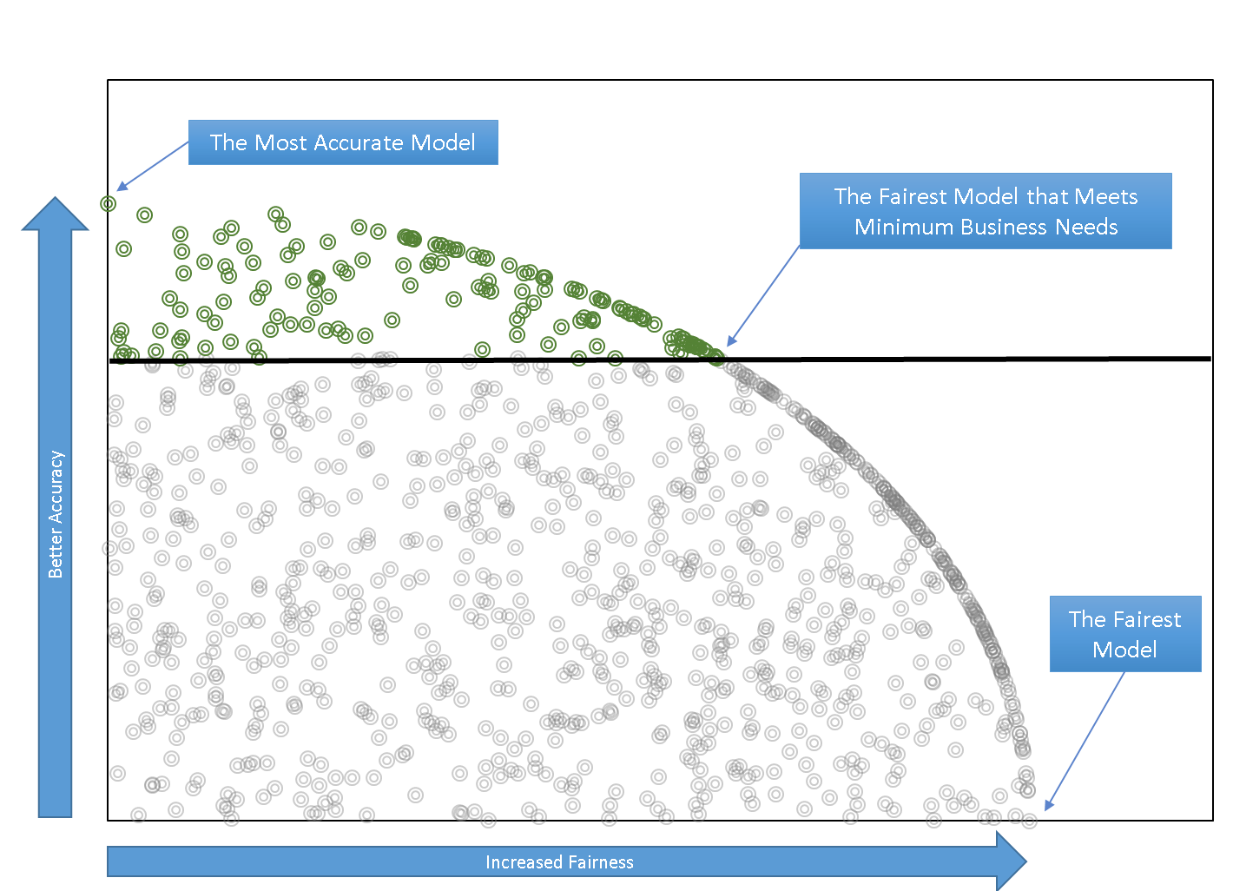
Using AI to Fix AI: the Pareto Frontier

Slide 30
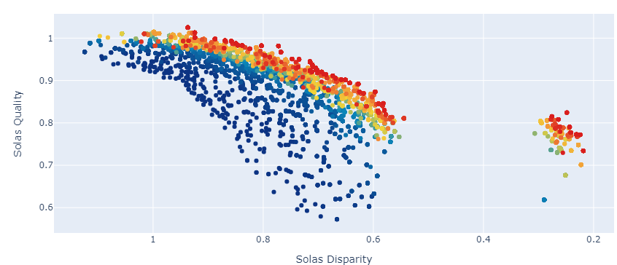
Using AI to Fix AI: A Real-world Example

Slide 31
Available techniques for mitigating discrimination
Fix Biased Algorithms
Feature Selection
Algorithm Selection
Adversarial Modeling
Data Preprocessing
Regularization
Model Tuning
Many options
Choice matters!
Good intentions may lead to harm
Most open-source implementations have limited in-production capability
IBM Fairness 360
Fairlearn
Aequitas
Open-access testing capabilities
SolasAI (https://github.com/SolasAI/solas-ai-disparity)

Slide 32
Pitfalls in Fairness Analyses
Putting garbage or risky data in a model
Are the features discriminatory?
Not measuring disparities considering actual outcomes
Ensure thresholds correspond to practice
Getting compliance advice from people with no compliance or business experience
Expertise is essential
Running the cool new de-biasing algorithm
But does it follow regulatory compliance?
What is it accomplishing?
Getting too attached to the model you’ve chosen
There are almost certainly many other similar models

Slide 33
Thank you!
Nicholas Schmidt
nick@solas.ai

